Slide 1
AIDI 1010 – Introduction to Emerging Technologies WEEK5
Jahanzeb Abbas (JB)

Slide 2
Week Objectives
Use AutoML for classification, regression, and forecasting
(A) TPOT
What is it?
(B) TPOT
Pros/Cons
Hyperparameters
(C) Example
(D) References

Slide 3
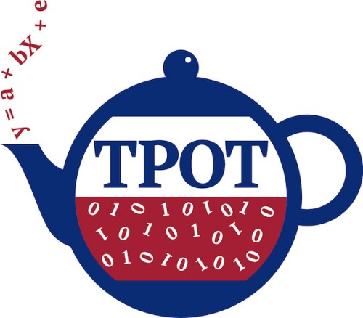
(A) TPOT (What is it?)
TPOT = “Tree-Based Pipeline Optimization Tool”; a library/module enabling AutoML
It was made by Randal S. Olson, et al. in 2016;
All documentation is available on: https://epistasislab.github.io/tpot/
It is based on scikit-learn and available as open-source
All details are provided on its GitHub: https://github.com/EpistasisLab/tpot/
It is meant to be a Data Science Assistant; uses “genetic programming” that optimizes ML pipelines; automates most tedious part of ML by intelligently exploring thousands of possible pipelines to find the best one for your data
It can be used for regression, classification, and special implementations; it is based on genetic search algorithm (helps to choose the best parameters and model ensembles) aka ‘natural selection’ or evolutionary algorithm
It attempts a pipeline, evaluates it, and randomly modifies parts of pipeline for performance assessment
It performs multiple preprocessing steps (missing values, scaling, feature selection,

Slide 4

TANGENT: Genetic Programming (GP)
http://geneticprogramming.com/
GP is an Evolutionary Algorithm (EA), a subset of ML which is used to discover solutions to problems similar to how humans don’t know how to solve everything initially
GP allows no human preconceptions or biases
GP is inspired by biological fundamentals of evolution (Darwinian Process of Natural Selection), and implements an algorithm that uses random mutation, crossover, fitness function, and multiple generations of evolution to resolve a user-defined task
GP has three main properties:
Selection – population of possible solutions and fitness function, then at every iteration each fit is evaluated
Crossover – selecting the fittest solution and performing crossover to create a new population
Mutation – taking their children and mutating them with some random modification until you get the best solution
Generational Algorithm in GP:
http://geneticprogramming.com/about-gp/gp-workflow/
GPs can help discover the following:
Functional relationship between features in data (Symbolic Regression)
Grouping data into categories (Classification)
Design of electrical circuits, antennae, and quantum algorithms

Slide 5
TANGENT: Fitness Function
https://towardsdatascience.com/how-to-define-a-fitness-function-in-a-genetic-algorithm-be572b9ea3b4
Fitness Function evaluates how close a given solution is to the optimum solution of the desired problem
How best a solution fits
Aka Evaluation Function
Since each solution is represented in binary numbers, aka chromosomes in generational algorithms, they have to be tested and given a score based on how close it is to the desired solution
The score is applied by fitness function on results obtained from tested solution
Examples include, trying to make a timetable where no schedules clash with each other.. this is where fitness functions are needed to ensure the most optimal timetable is created
“Less number of students with class conflicts – the more fit the class is”

Slide 6
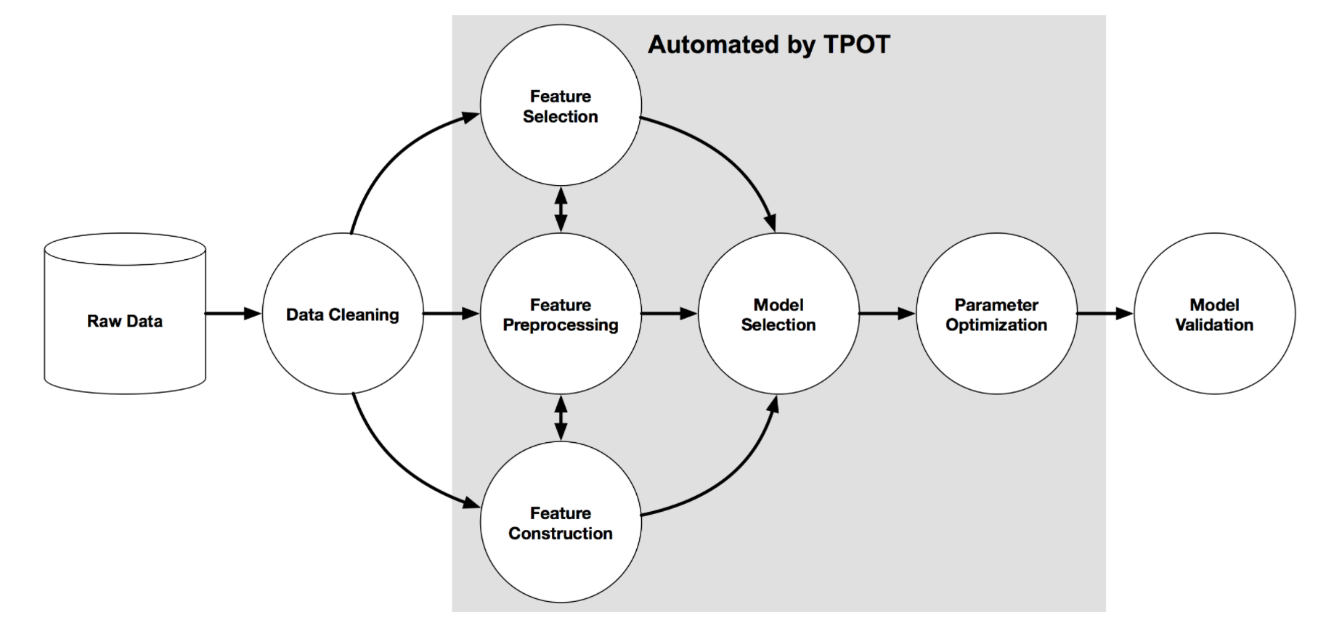
TANGENT: TPOT – Data Science Assistant

Slide 7
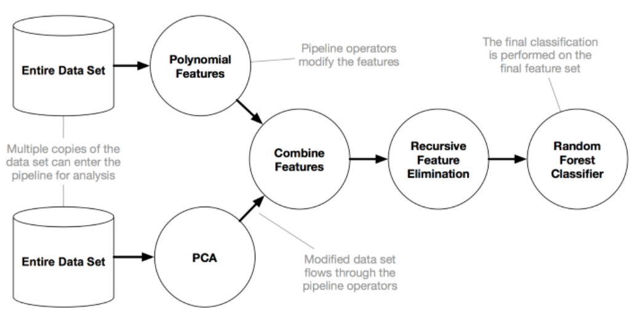
TANGENT: TPOT – Pipeline

Slide 8
TANGENT: PCA
Principal Component Analysis (PCA)
ML method to reduce number of features in a dataset
A fundamental step in any project in order to reduce the chance of overfitting
Follow a step-by-step guide by Shivesn Chaturvedi on Coders Packet:
https://coderspacket.com/preprocessing-of-data-using-pca-principal-component-analysis

Slide 9
(B) TPOT: Pros/Cons
PROS | CONS
Designed as a Data Scientist Assistant | Not designed for automated deep learning
Open Source & Community Support (Decent Documentation) | Needs lots of time (hours or even a day) for optimal results
Genetic Programming (natural selection like model selection) | Slow processing speed (have to configure parameters for faster performance)
Different TPOT runs might result in different pipeline recommendations, as optimization algorithm is stochastic in nature; however, it always chooses the best model for same dataset | Not simple to install

Slide 10
(B) TPOT: Hyperparameters
Parameter name | Default value | Description
generations= | 100 | # of iterations to the run pipeline optimization process. Generally, TPOT will work better when you give it more generations (and therefore time) to optimize the pipeline.
population_size | 100 | # of individuals to retain in the genetic programming population every generation. Generally, TPOT will work better when you give it more individuals with which to optimize the pipeline.
offspring_size= | None | Number of offspring to produce in each genetic programming generation. By default, the number of offspring is equal to the number of population size.
mutation_rate= | 0.9 | Mutation rate for the genetic programming algorithm in the range [0.0, 1.0]. This parameter tells the GP algorithm how many pipelines to apply random changes to every generation.
crossover_rate= | 0.1 | Crossover rate for the genetic programming algorithm in the range [0.0, 1.0]. This parameter tells the genetic programming algorithm how many pipelines to "breed" every generation.
scoring= | Accuracy | Function used to evaluate the quality of a given pipeline for the classification problem.
cv= | 5 | Cross-validation strategy used when evaluating pipelines. StratifiedKFold can be used as an example.
subsample= | 1.0 | Fraction of training samples that are used during the TPOT optimization process. Must be in the range (0.0, 1.0].
n_jobs= | 1 | Number of processes to use in parallel for evaluating pipelines during the TPOT optimization process.
max_time_mins= | None | How many minutes TPOT has to optimize the pipeline. If not None, this setting will allow TPOT to run until max_time_mins minutes elapsed and then stop. TPOT will stop earlier if generations is set and all generations are already evaluated.
max_eval_time_mins= | 5 | How many minutes TPOT has to evaluate a single pipeline. Setting this parameter to higher values will allow TPOT to evaluate more complex pipelines, but will also allow TPOT to run longer. Use this parameter to help prevent TPOT from wasting time on evaluating time-consuming pipelines.
random_state= | None | The seed of the pseudo random number generator used in TPOT. Ensures that TPOT gives you the same results each time you run it against the same data set with that seed.
config_dict= | None | A configuration dictionary for customizing the operators and parameters that TPOT searches in the optimization process.
warm_start= | False | Flag indicating whether the TPOT instance will reuse the population from previous calls to fit(). Setting warm_start=True can be useful for running TPOT for a short time on a dataset, checking the results, then resuming the TPOT run from where it left off.
memory= | None | If supplied, pipeline will cache each transformer after calling fit. This feature is used to avoid computing the fit transformers within a pipeline if the parameters and input data are identical with another fitted pipeline during optimization process.
periodic_checkpoint_folder= | None | If supplied, a folder in which TPOT will periodically save pipelines in pareto front so far while optimizing.
early_stop= | None | How many generations TPOT checks whether there is no improvement in optimization process. Ends the optimization process if there is no improvement in the given # of generations.
verbosity= | 0 | How much information TPOT communicates while it's running. Try using “2” or “3” to see the progress of model evolution and training score improvement.
disable_update_check= | False | Flag indicating whether the TPOT version checker should be disabled. The update checker will tell you when a new version of TPOT has been released.
https://epistasislab.github.io/tpot/api/

Slide 11

(C) TPOT: Example

Slide 12
TANGENT: Cross-Validation
https://youtu.be/7062skdX05Y
Prior to model creation, we perform train_test_split
Model will use the % to train the model itself, and remaining% to check the accuracy
Upon train_test_split - %s are randomly selected, try to define random_state parameter
Accuracy fluctuates based on change in random_state parameter
In order to prevent the above – Cross Validation exists
Type1: Leave One Out CV -> LOOCV => Select one record at a time to test, per iteration (leads to low bias but lots of iterations, error rate is high and accuracy goes down). No longer used.
Type2: KFoldCV => Use a value for K, divide dataset by K and select those # of records at a time to test, per iteration. Easier to communicate accuracy to stakeholders as one can take a mean value of accuracy percentages (lower number of iterations but gives an imbalanced dataset)
Type3: Stratified K Fold CV => Use a value of K, divide dataset by K and select those # of records at a time to test, per iteration. However, in this CV - every time test/train data is selected, # of instances of each class for each iteration/experiment is taken in a proper way. This fixes the Kfold problem previously identified.
https://scikit-learn.org/stable/modules/generated/sklearn.model_selection.StratifiedKFold.html
Type4: Time-Series CV => Applicable to time-series based data (i.e: stock data), where there’s a dependency within the data structure itself.

Slide 13
Disclaimer
Due to nature of the course, various materials have been compiled from different open source resources with some moderation.
The course designer (slides creator), sincerely acknowledges their hard work and contribution, credit will be given wherever necessary

Slide 14
References
https://neptune.ai/blog/a-quickstart-guide-to-auto-sklearn-automl-for-machine-learning-practitioners
https://youtu.be/jn-22XyKsgo
https://youtu.be/K490SP-_H0U
https://youtu.be/TQUbh_E8nb0
https://www.alibabacloud.com/blog/6-top-automl-frameworks-for-machine-learning-applications-may-2019_595317
https://www.kaggle.com/soham1024/know-about-different-automl-frameworks?scriptVersionId=43751621#Pros-and-cons
https://www.hindawi.com/journals/mpe/2013/312067/tab2/
https://towardsdatascience.com/tpot-automated-machine-learning-in-python-4c063b3e5de9
https://coderspacket.com/preprocessing-of-data-using-pca-principal-component-analysis
https://epistasislab.github.io/tpot/
http://geneticprogramming.com/
https://towardsdatascience.com/how-to-define-a-fitness-function-in-a-genetic-algorithm-be572b9ea3b4
https://towardsdatascience.com/tpot-automated-machine-learning-in-python-e56800e69c11
https://www.analyticsvidhya.com/blog/2021/05/automate-machine-learning-using-tpot%E2%80%8A-%E2%80%8Aexplore-thousands-of-possible-pipelines-and-find-the-best/
https://machinelearningmastery.com/case-study-predicting-the-onset-of-diabetes-within-five-years-part-3-of-3/
https://machinelearningmastery.com/tpot-for-automated-machine-learning-in-python/
https://towardsdatascience.com/automl-in-python-a-comparison-between-hyperopt-sklearn-and-tpot-8c12aaf7e829

Slide 15

Thank You Very Much
Any Questions?

